Slide 1
The Environment, Rights, CHildren PROJECT
ENRICH opening online event
25 February 2025
Csaba Kiss, Coordinator, Justice & Environment

Slide 2
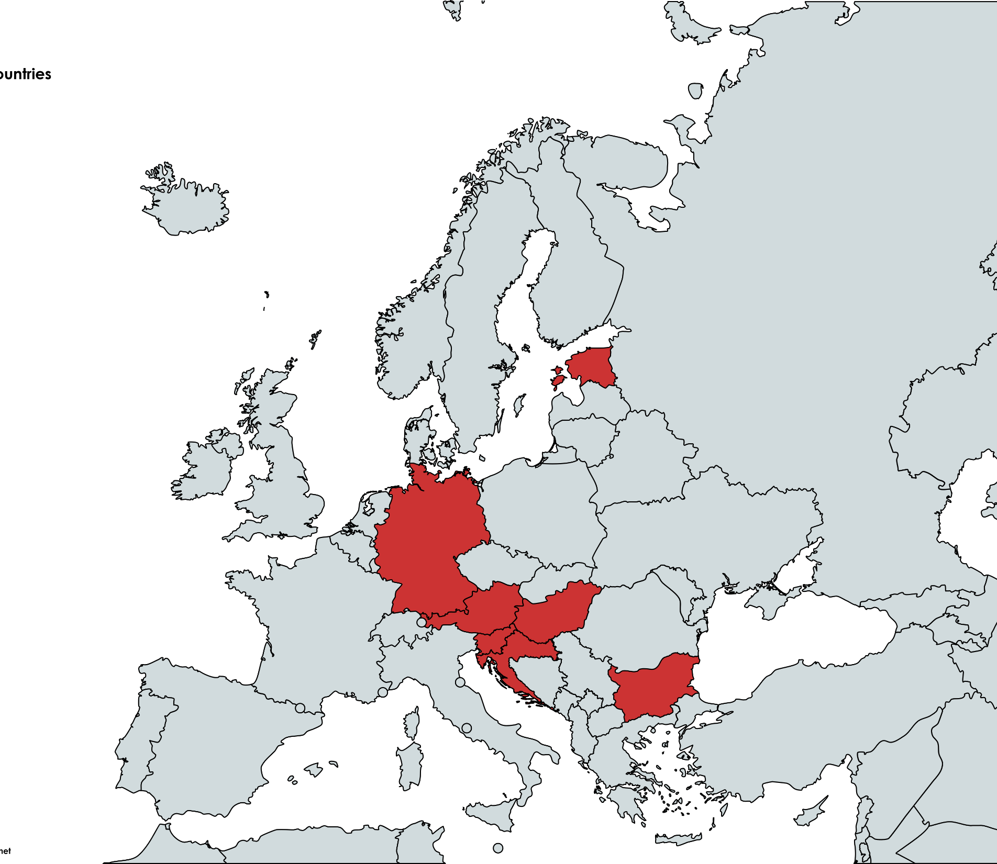
Basic project data
Main beneficiary: Association J&E
Project coverage: 7 countries – 7 NGOs (see map)
Duration: 01/05/2024 – 30/04/2026
Main topic: Child rights with special regard to participation in environmental and climate matters
Target audience:
Environmental and child rights NGOs and activists
Environmental educators, teachers, academia
Official bodies dealing with children and environmental matters

Slide 3
Basic project data
Project actions:
Survey of child rights and environmental rights awareness
Legal studies on child participation
3 training/education events in each country
Opening and closing online webinars
Project outputs: advocacy submission

Slide 4
Thank you! www.justiceandenvironment.org

