Slide 1
How to ensure meaningful respect for children's human right to be heard and freedom of expression in environmental decision-making processes?
Prof Elisa Morgera
Distinguished professor of global environmental law, university of Strathclyde

Slide 2
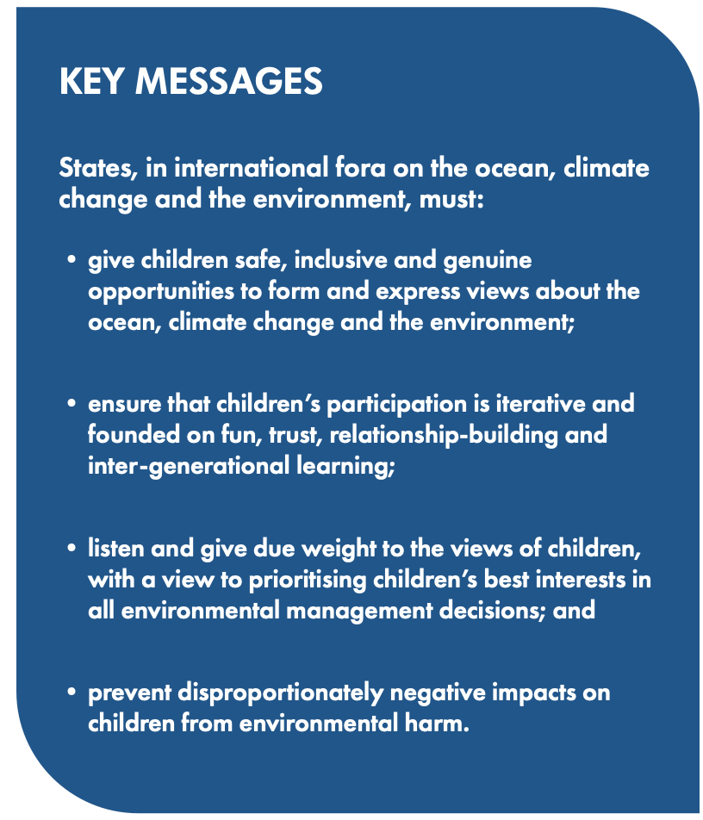
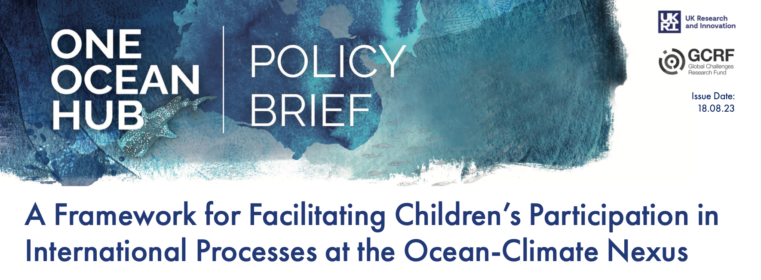
Notes:
Open-access academic article at: https://brill.com/view/journals/estu/aop/article-10.1163-15718085-bja10140/article-10.1163-15718085-bja10140.xml
Full policy brief at: https://oneoceanhub.org/wp-content/uploads/2023/08/Policy-Brief-A-Framework-for-Facilitating-Childrens-Participation-in-International-Processes-at-the-Ocean-Climate-Nexus_29.08.23.pdf

Slide 5
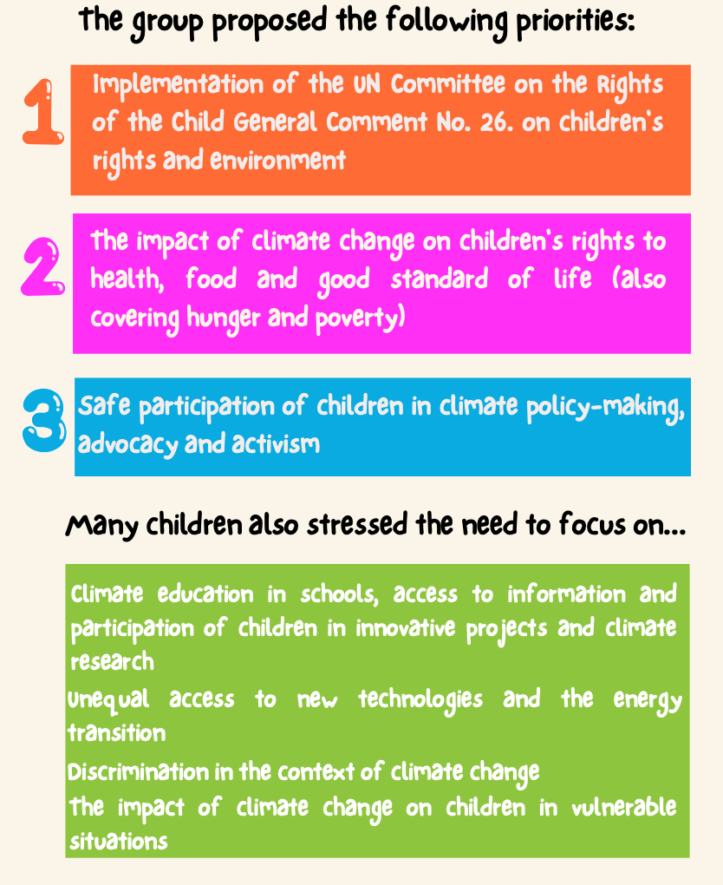

Slide 6
Notes:
Link to the full reflection on the consultation process in 2024: https://www.ohchr.org/sites/default/files/documents/issues/climatechange/activities/consultations-2024-executive-summary-for-page.pdf

Slide 7
TikTok: climaterights4kids
Instagram : climaterights4kids
Gmail: climaterights4kids@gmail.com
Launch in March 2025 – stay tuned!

Slide 8
Iterative learning
Reflection and self-reflection

Slide 9
Connecting learning & amplifying local voices across international “ocean-climate” governance
Human rights (interdependency) + ecosystem approach
(connectivity)
= mutually supportive interpretations of international law (policy coherence/ SDG 17.14)
Arts to connect local & global experiences
= prioritizing needs of most vulnerable (leave no-one behind) → ocean, sust dev and climate funding!
International recognition of the human right to a healthy environment
New UN General Comment on children’s right to a health environment (2023)
UN Decade for Ecosystem Restoration
Kunming-Montreal Global Biodiversity Framework
BBNJ Agreement (on marine biodiversity of areas beyond national jurisdiction)
Requests for advisory opinions on climate change:
ITLOS
ICJ
InterAm Court
intergovernmental negotiating committee on a new treaty on plastics
Fisheries
Subsidies Agreement
Negotiations of Pandemic Treaty
International watercourses law
UN Decade for Ocean Science

